Slide 1
Hispanic Heritage Month
History
Hispanic Heritage Month (September 15–October 15) in the United States is the period when people recognize the contributions of Hispanic Americans to the United States and to celebrate Hispanic Cultural heritage and Hispanic culture. Hispanic Heritage Week was approved by President Lyndon Johnson and was expanded by President Ronald Reagan in 1988 to cover a 31-day period. It was enacted into law on August 17, 1988 on the approval of Public Law 100-402.
"September 15 was chosen as the starting point for the celebration because it is the anniversary of independence of five Latin American countries: Costa Rica, El Salvador, Guatemala, Honduras and Nicaragua. They all declared independence in 1821. In addition, Mexico, Chile and Belize celebrate their independence days on September 16, September 18, and September 21, respectively."
Hispanic Heritage Month also celebrates the long and important presence of Hispanic Americans in North America. A map of late 18th century North America shows this presence, from the small outpost of San Francisco founded in the desolate wilderness of Alta California in 1776, through the Spanish province of Texas with its vaqueros (cowboys), to the fortress of St. Augustine, Florida -- the first continuous European settlement in North America founded in 1565, decades before Jamestown, Virginia.

Slide 2
Country-Flag Game!
Guess what flag represents what country!
Ready, set, go!

Slide 3

ARGENTINA!

Slide 4

GUATEMALA

Slide 5
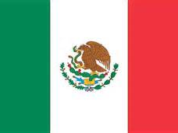
MEXICO

Slide 6
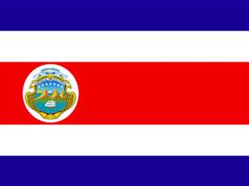
COSTA RICA

Slide 7

VENEZUELA

Slide 8

HONDURAS

Slide 9

PANAMA

Slide 10

COLOMBIA

Slide 11
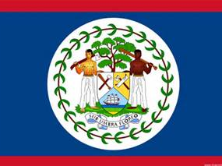
BELIZE

Slide 12

EL SALVADOR

Slide 13

NICARAGUA

Slide 14
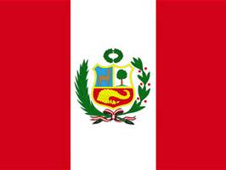
PERU

Slide 15
CAN YOU NAME OTHER COUNTRIES THAT ARE PART OF THE HISPANIC HERITAGE MONTH?

